Slide 1
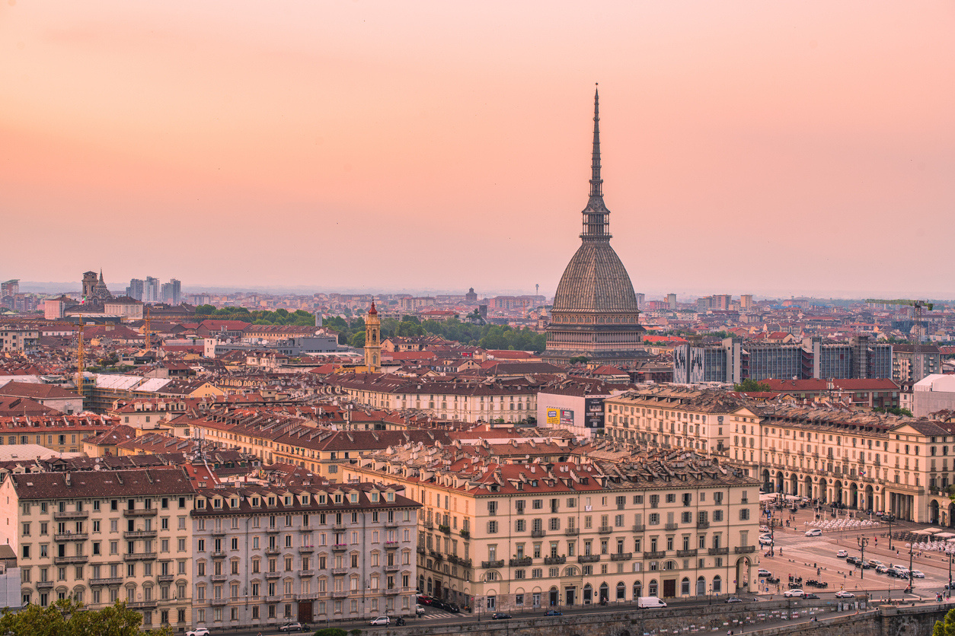


INTERNATIONAL FORUM OF ITALIAN TOURISM
3^ EDITION

Slide 2






INTERNATIONAL
FORUM OF ITALIAN TOURISM
22 APRIL
PIEDMONT
Il Forum Internazionale del Turismo Italiano (International Forum of Italian Tourism) opens opportunities for dialogue among the most authoritative figures from the economic world, national and local institutions, and industries closely connected to the tourism sector.
Now in its 2nd edition, this comprehensive itinerary of major events serves as a valuable resource to monitor and understand the state of tourism in Italy year after year.
The key themes developed in this itinerant project will focus on Italy's landscape, cultural, and hospitality excellences.
TARGET
NATIONAL AND LOCAL INSTITUTIONS, HOTELS, TOURISM BODIES, LOCAL AND NATIONAL MOBILITY, CULTURAL ASSOCIATIONS, MUSEUMS AND MUSEUM CENTRES, OPERA HOUSES, ENTREPRENEURS, SPORTS SECTOR, TERRITORIAL MARKETING AGENCIES
2025 EDITION
REGISTERED USERS: 980
ATTENDEES: OVER 1,200*
*also broadcast on the homepage of ilsole24ore.com

Slide 3

POSSIBLE TOPICS
The evolution of tourism policies in Italy: what has been done and what still needs to be done
Artificial intelligence and data to personalize the travel experience
Experiencing places and people: the slow travel trend
Culture, food and wine, landscape and sustainability: the Langhe model
Multigenerational holidays: strategies to meet different ages and expectations
New types of accommodation: short-term rentals, holiday homes, and stays in villages or inland areas
When tourism integrates with culture and urban development: the case of the Egyptian Museum of Turin
Major sporting events as a driver of tourism
Experiencing the mountains today: policies, innovation and sustainability in highland areas
Public and private funding for the tourism industry
Inclusion and accessibility of destinations: digital payments serving the tourism sector

Slide 4
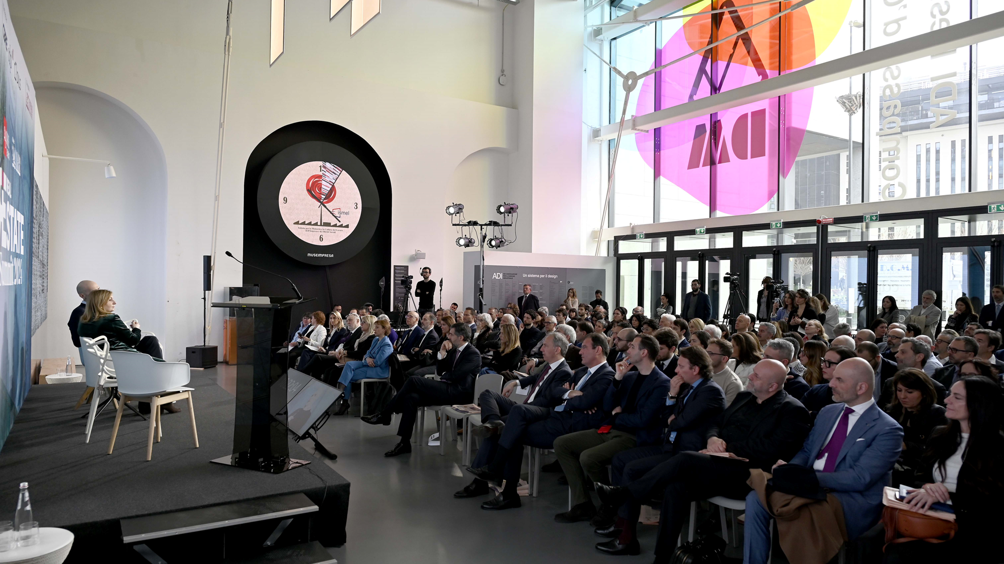
ED. 2025
THE NUMBERS
21
SPEAKERS
7
SPONSORS
980
REGISTERED
USERS
1.200
PARTECIPANTS

Slide 5
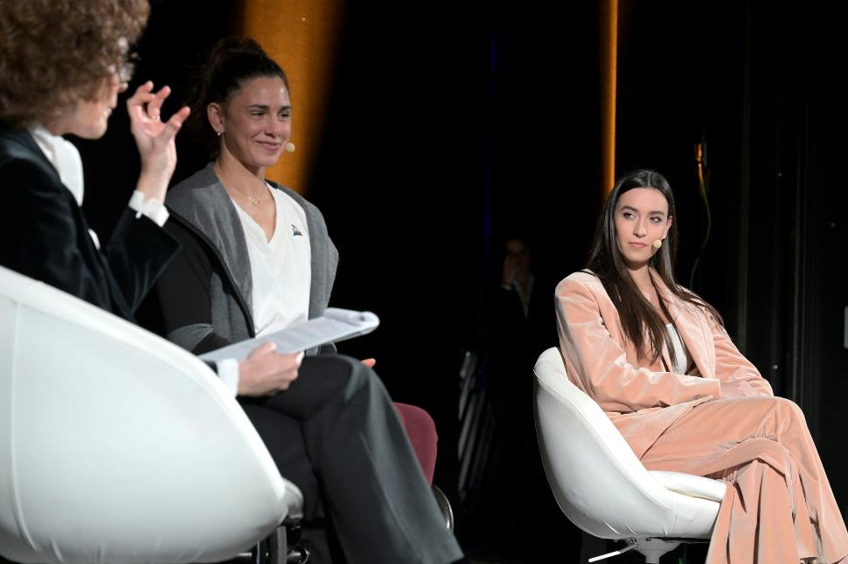
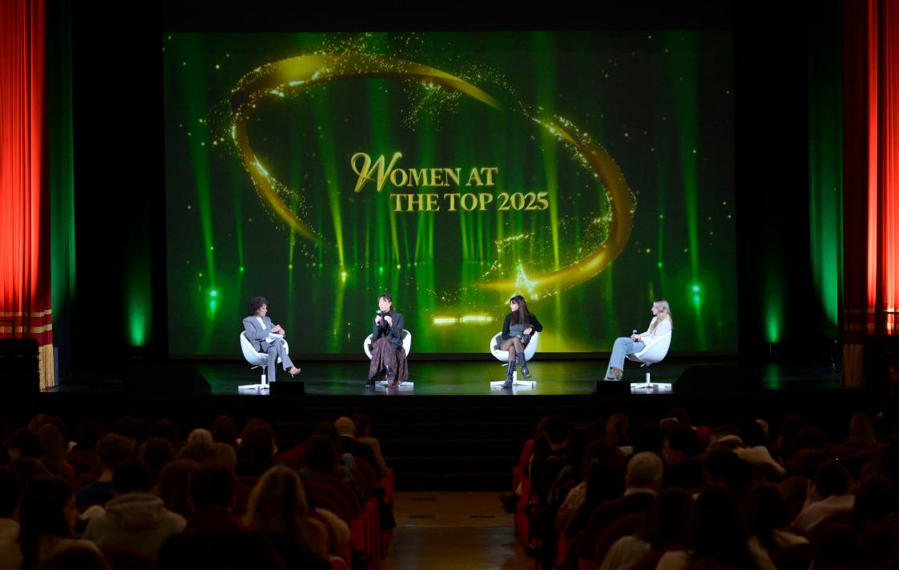
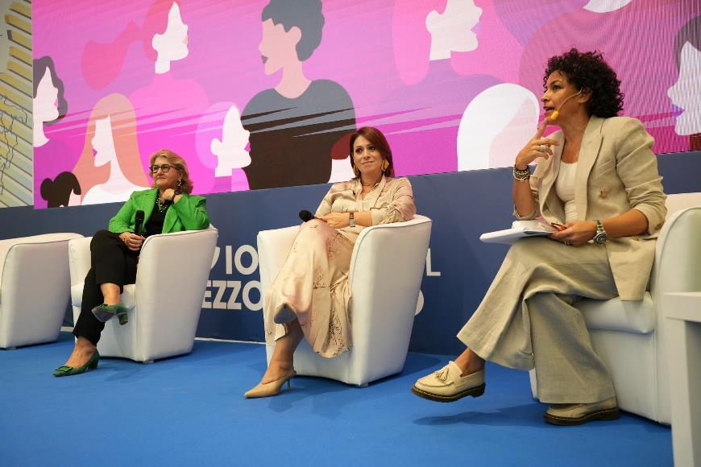
GENDER
EQUALITY
We are the first Italian publishing group to be certified on Gender Equality according to UNI/PdR 125:2022.
This milestone was achieved thanks to a significant shift in corporate culture towards a more sustainable and inclusive perspective.
This commitment is confirmed in the design of the programmes for all our events.
25%
10%
25%
10%
FEMALE
SPEAKERS
UNDER 50
SPEAKERS
RELATRICI DONNE
RELATORI UNDER 50

Slide 6






CONCEPT & FORMAT
CONCEPT
Event with a live audience and broadcast live via streaming.
Individual speeches, study presentations, round table discussions, remote or recorded speeches are alternated. A Q&A session may be scheduled.
FORMAT
Live & Digital Event: participate in-person or via the platform. User registration required.
It is possible to watch the event on demand on the dedicated landing page.
DURATION: 3 hours

Slide 7

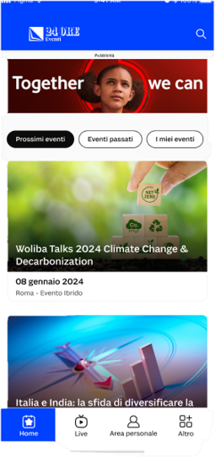
AN INTERACTIVE EXPERIENCE
Through streaming digitisation and with a director coordinating the speeches, live events can be transformed into interactive streaming events.
Event registrants will have access to a section/entry page with a customised player to enjoy a cross-screen and cross-device video stream, with real-time optimisation on the content display.
The streaming format will allow the scheduled insertion of video material and detailed images of the speakers' speeches.
Added to this is the possibility of introducing live surveys: the audience will be able to participate in real time and answer directly through the dedicated app, making the experience even more dynamic and engaging.
KEY BENEFITS
Simultaneous connection of thousands of users
Remotely connecting speakers wherever they are (Italy / Abroad) and inserting Q&A sessions (moderated chat)

Slide 8














WE MAKE EVERY
EVENT UNIQUE
Filming with HD cameras, guaranteed by the director
Opportunity for interaction with both
in-person and remote audiences (e.g. polls)
Guests accompanied on stage by graphics and background music
Possibility to connect guests remotely via a platform
Partner logo video displayed in the waiting room
Opening theme song of the programme
Setting up a set at the chosen location

Slide 9
COMMUNICATION CAMPAIGN
WEB & DIRECT MARKETING*
CAMPAGNA BANNER*
POSIZIONI FISSE SUL .COM
Dedicated landing page on the website 24oreventi.ilsole24ore.com
No. 3 Direct E-Mail Marketing (DEM) with a profiled target from the Il Sole 24 Ore database
MPU box on the website www.ilsole24ore.com
Box Format (300x250)
Duration: 1 week before the event
Box Brand Connect ROS on the website www.ilsole24ore.com
Manchette on the homepage www.ilsole24ore.com
ON SITE*
STAMPA*
Venue and entrance setup
2 advertisements in Il Sole 24 Ore
Half-page format (60 modules, 312x222)
*Materials where the partner logo will be displayed

Slide 10



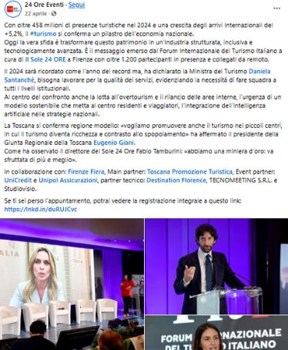
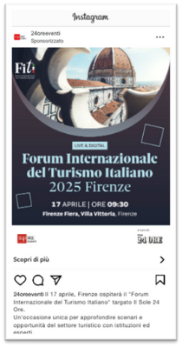
SOCIAL MEDIA COMMUNICATION
4 weeks of engagement across the social media platforms of the entire network
Meta + Linkedin to maximise the reach of the message and intercept the target audience
LAUNCHES - PRE-EVENT
THEMATIC INSIGHTS
GALLERY - POST EVENT

Slide 11
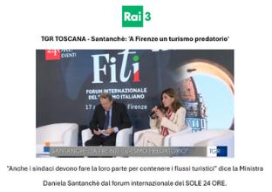
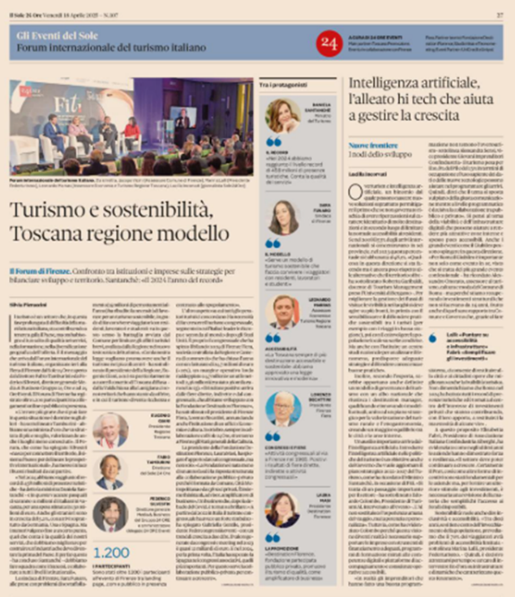
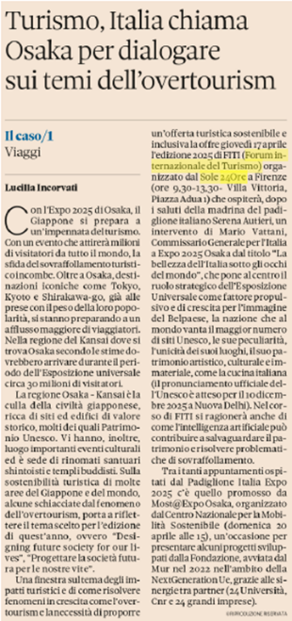
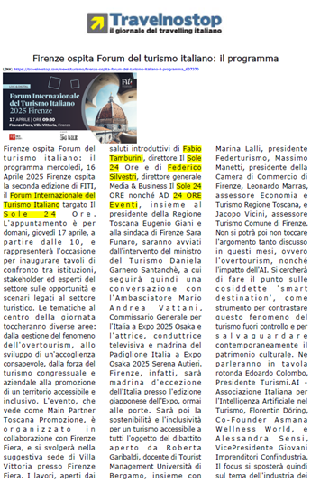
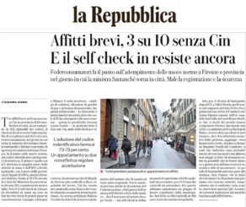
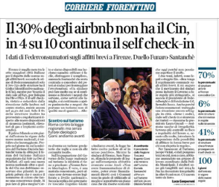
ED. 2025
EDITORIAL FOOTAGE

Slide 12

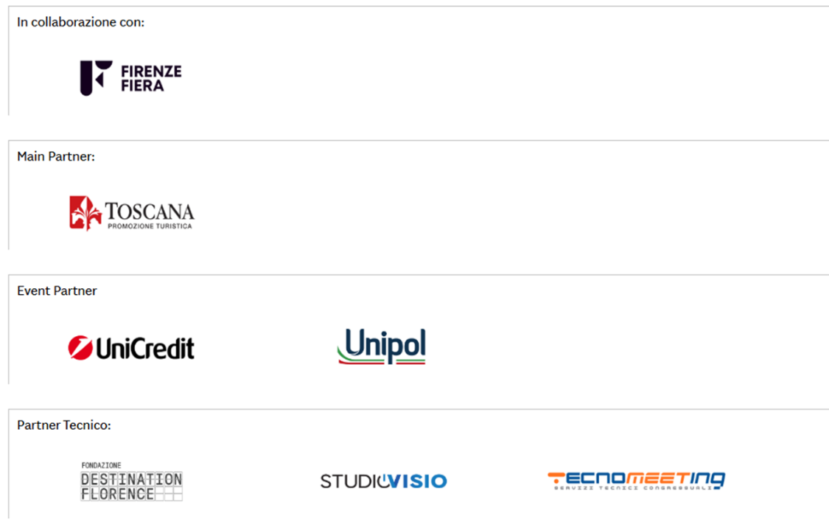

ED. 2025
THE PARTNERS

Slide 13


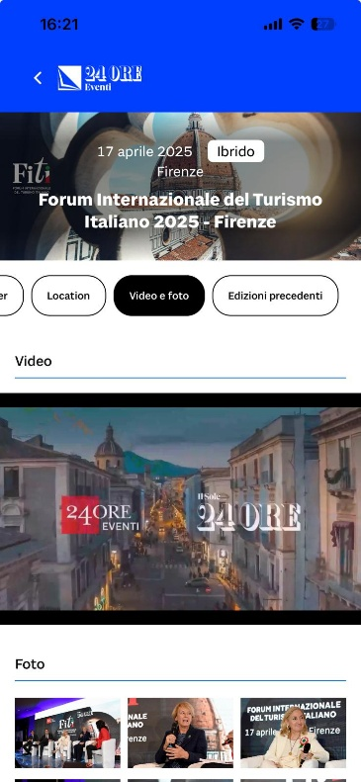

POST-EVENT VISIBILITY/1
The full video of the event will be available:
within the events area in the video section on the website ilsole24ore.com
on the event landing page on the website 24oreventi.ilsole24ore.com
inside the event page, in the ‘videos and photos’ section of our 24 ORE Eventi app

Slide 14

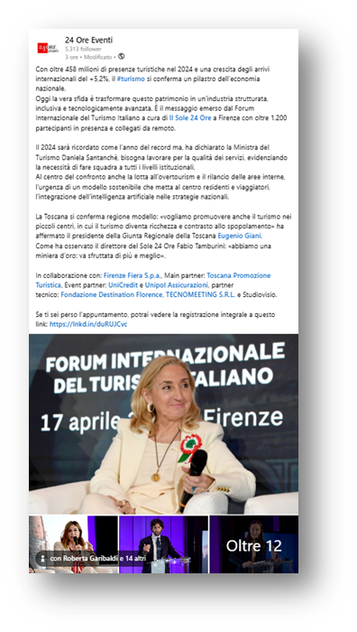

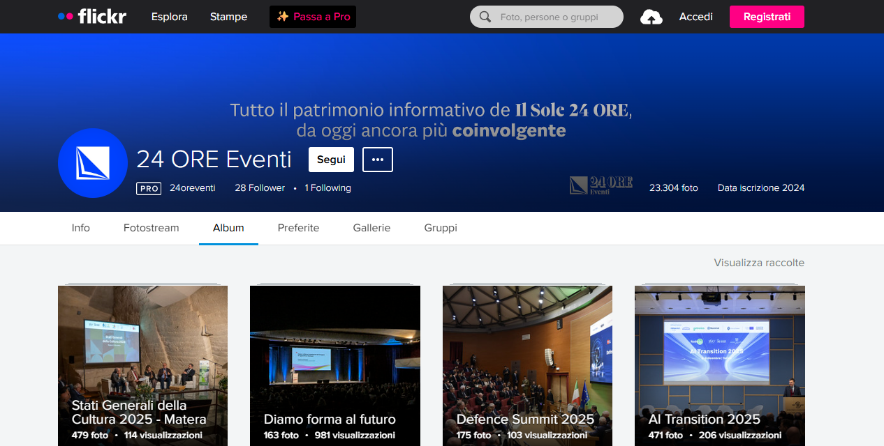
POST-EVENT VISIBILITY/2
THANK YOU EMAIL MARKETING
POST-EVENT VIDEOS ON SOCIAL MEDIA PLATFORMS
FLICKR
On the event page, in the “videos and images” section, the link to the Flickr platform with all the photos will be available.

Slide 15
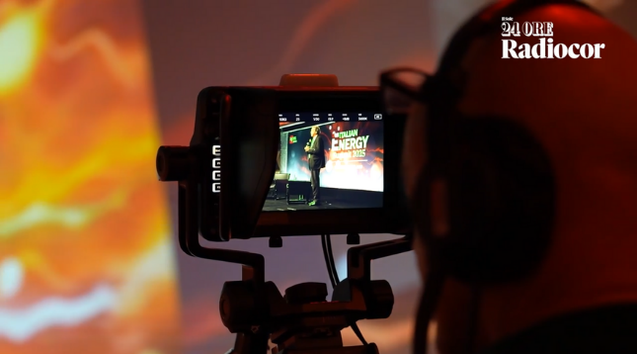
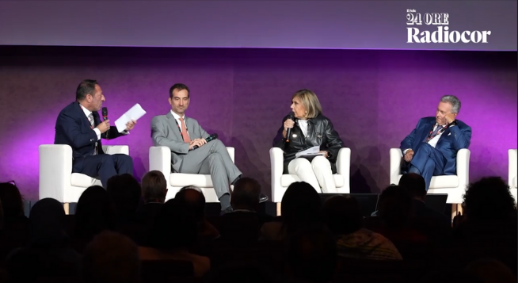
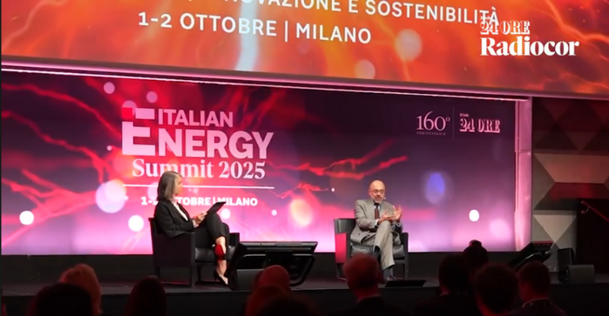


VIDEO INTERVIEWS
Single video interviews by a journalist from Il Sole 24 Ore Radiocor and filmed during the event with a crew of one cameraman and one video camera, amplifying the topics discussed at the event.
Each video interview will last 2 to 3 minutes and, in addition to being sent to the client to share on their own channels, it will be:
Published on the sole24ore.com website in the Radiocor section, at the discretion of the Editorial Team
Re-launched on the Il Sole 24 ORE Radiocor Linkedin profile (160,000 followers)
Published on the 24 ORE Eventi website

Slide 16


MAIN PARTNER
INVESTMENT REQUIRED
€36,000 net with video interview
€30,000 net without video interview
CREATION OF AN AD HOC FOCUS
SPEECHES
ad hoc focus by a representative of the partner + 2 case history representatives from client companies
TICKER
PROMOTIONAL VIDEO
insertion of 1 promotional pop-up at the bottom of the screen during the broadcast
(728x90mm, static png)
possibility of broadcasting a video of up to 30 seconds in the waiting room before the beginning of the activities
LOGO VISIBILITY
INFORMATION MATERIAL
on all promotional material for the event (ADV, DEM, banners, landing pages) and on the opening and closing theme
download of partner material from the event landing page
LEAD GENERATION
POST-EVENT REPORT
delivery of a file containing the names of the registered users on the platform, in compliance with GDPR regulations
provided to the partner, with the following KPIs: subscribers, participants, leads

Slide 17


MAIN PARTNER
INVESTMENT REQUIRED
€31,000 net with video interview
€25,000 net without video interview
ONE TO ONE SESSION
SPEECHES
one-to-one session by a partner
representative
PROMOTIONAL VIDEO
TICKER
insertion of 1 promotional pop-up at the bottom of the screen during the broadcast
(728x90mm, static png)
possibility of broadcasting a video of up to 30 seconds in the waiting room before the beginning of the activities
LOGO VISIBILITY
INFORMATION MATERIAL
on all promotional material for the event (ADV, DEM, banners, landing pages) and on the opening and closing theme
download of partner material from the event landing page
LEAD GENERATION
POST-EVENT REPORT
delivery of a file containing the names of the registered users on the platform, in compliance with GDPR regulations
provided to the partner, with the following KPIs: subscribers, participants, leads

Slide 18



OFFICIAL PARTNER
INVESTMENT REQUIRED
€21,000 net with video interview
€15,000 net without video interview
SPEECH AS PART OF A ROUNDTABLE DISCUSSION
SPEECHES
speech in a roundtable discussion on
agreed-upon topics
TICKER
PROMOTIONAL VIDEO
insertion of 1 promotional pop-up at the bottom of the screen during the broadcast
(728x90mm, static png)
possibility of broadcasting a video of up to 30 seconds in the waiting room before the beginning of the activities
INFORMATION MATERIAL
LOGO VISIBILITY
download of partner material from the event landing page
on all promotional material for the event (ADV, DEM, banners, landing pages) and on the opening and closing theme
LEAD GENERATION
delivery of a file containing the names of the registered users on the platform, in compliance with GDPR regulations
POST-EVENT REPORT
provided to the partner, with the following KPIs: subscribers, participants, leads

Slide 19

EVENT PARTNER
INVESTMENT REQUIRED
€12,000 net with video interview
VISIBILITY ON EVENT COMMUNICATION
PROMOTIONAL VIDEO
possibility of broadcasting a video of up to 30 seconds in the waiting room before the beginning of the activities
POST-EVENT REPORT
LOGO VISIBILITY
provided to the partner, with the following KPIs: subscribers, participants, leads
on all promotional material for the event (ADV, DEM, banners, landing pages) and on the opening and closing theme
LEAD GENERATION
delivery of a file containing the names of the registered users on the platform, in compliance with GDPR regulations
INFORMATION MATERIAL
download of partner material from the event landing page

Slide 20




KEY PERFORMANCE INDICATORS
SUBSCRIBERS
Number of users subscribed at the event
PARTICIPANTS
Number of users connected during the event
LEADS
File containing the leads that gave consent to the transfer of data to the event partner

