Slide 1
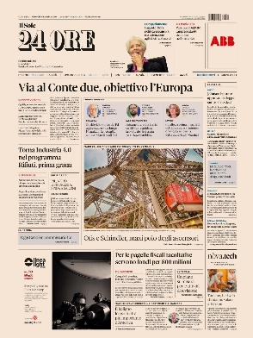
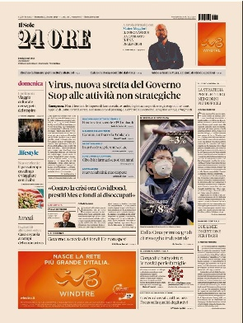
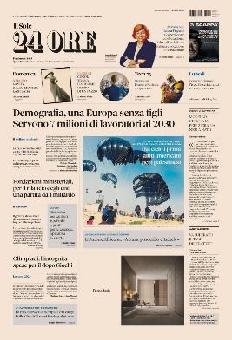
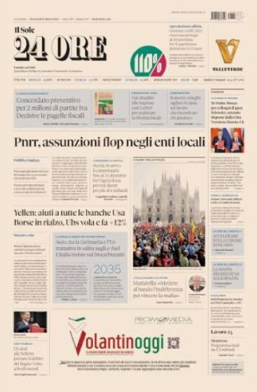
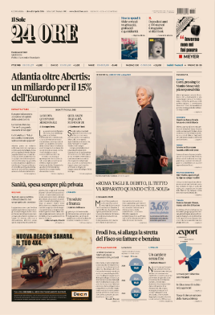

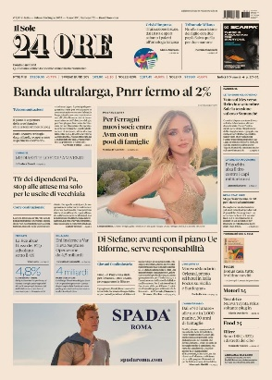
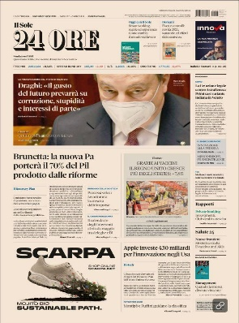
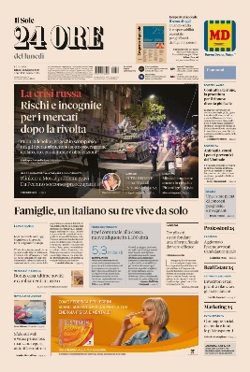
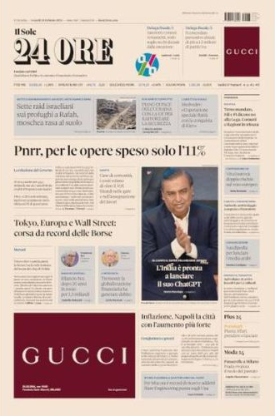
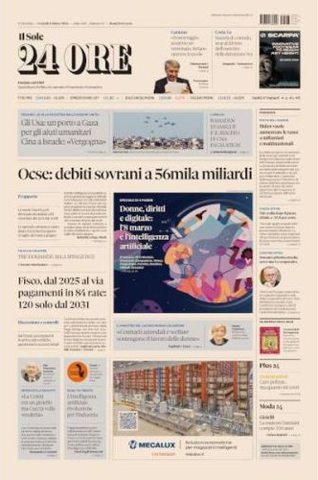

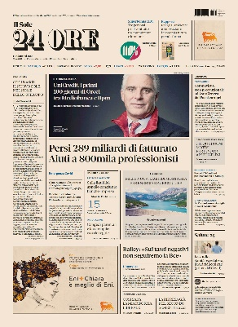
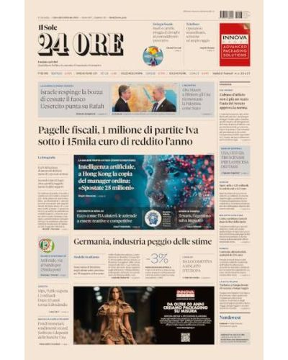
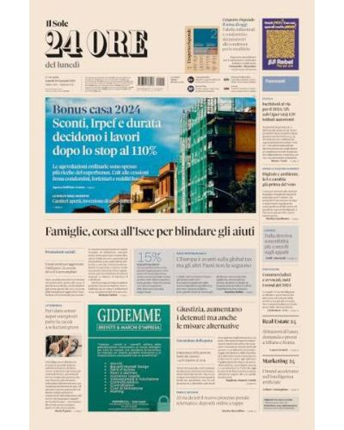
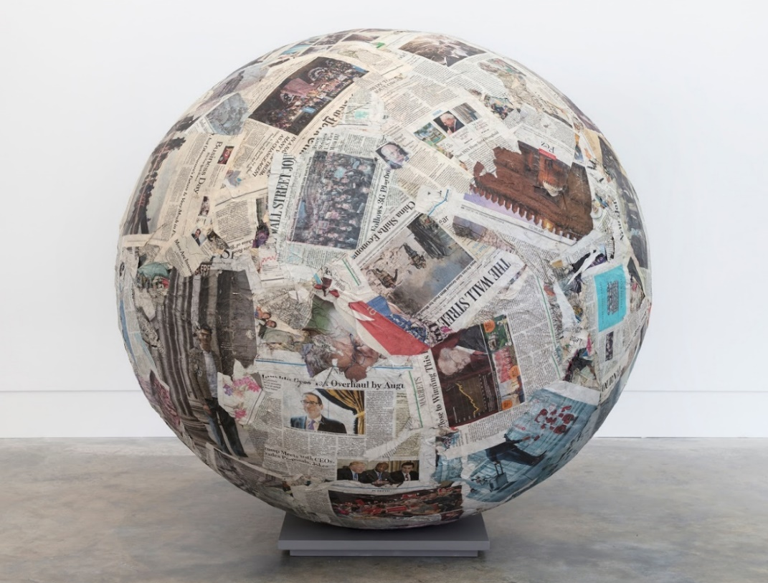


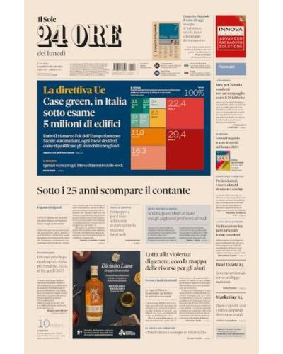
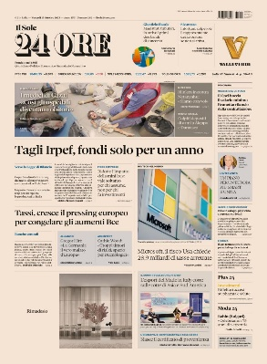
IL SOLE 24 ORE – Reports

Slide 2

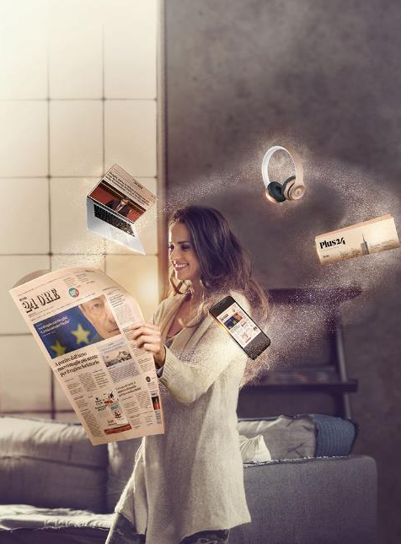

Reports
Reports are targeted analysis and investigations into the world, supply chains and important industries in Italy’s economic fabric. They describe the evolution of the most strategic sectors of the Italian economy, the performances and strategies of the companies that form part of it, as well as the challenges and new aspects of the market.
Featuring high-quality content and prestigious names, Reports add to the newspaper’s information provided and offer an ideal channel for targeted communication relating to the content of the business. Frequently handed out at trade shows and industry events, Reports cover well-established themed areas that are developed throughout the year.
»

Slide 3



Il Sole 24 ORE
The features
657,000 DAILY READERS
115,382
HIGH LOYALTY TO THE BRAND
% subscription on total circulation
TOTAL CICULATION
print + digital
82%
49%
55%
+
ILSOLE24ORE
Corriere
Repubblica
IL SOLE 24 ORE OCCUPIES THE 2ND POSITION FOR DIGITAL CIRCULATION IN THE PANORAMA OF DAILY PRESS *
DIGITAL COPIES
82,321
(*) net copies of sports newspapers on Monday Sources: Audipress 2025.2 Print and / or replication (absolute values) ADS November 2025.
»

Slide 4
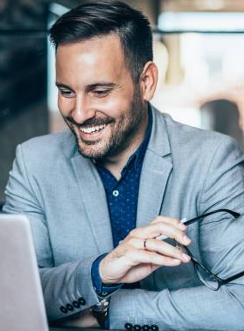
Reports
The target and the readers
The main target audience is represented by Institutions and operators in the sectors of industry, finance, transport, tourism, export, etc.
Frequently distributed within the sector fairs and events and winners of numerous journalistic prizes, the Reports cover consolidated thematic areas that are developed during the year.
The 35% of Il Sole 24 Ore readers is in the over 55 age group the one with the highest spending and investment capacity. 66% are men and 34% are women.
Source: Audipress 2025.2
»

Slide 5
Reports
2026 Calendar *
JANUARY
FEBRUARY
MARCH
APRIL
MAY
JUNE
JULY
SEPTEMBER
OCTOBER
NOVEMBER
DECEMBER
1 Nautical Industry
6
Company cars and business mobility
13
Beauty
20
Design
27
Sustainable development
13
Men’s Fashion Week
27 Exhibitions
3
Quality Certifications
10 Private Banking
17
Motors
24 Women’s Fashion Week
3
Design
10
Sustainable Development
17
Stars of the South
24
Job
31
Cars and corporate mobility
12
Wine economy
21 Design 22 Motorcycles scooters and microcars
28
Transport and logistics
5
Pet Economy
6
Beauty
11
Food economy
19
Jewellery
20
Sustainability Leader
25
Law Firms
3
Company cars and business mobility
9
Watches
16
Men’s Fashion Week
23 Private banking
30
Emilia Romagna
7
Motors
8 Sustainable Development
15 Watches
21 Exhibitions
21 Ceramic Industry
22
Women’s Fashion Week
29
Sustainable Development
3
Piemonte
10
Defense & Cybersecurity
17
Private Banking
18 Watches
24
Campania
25
Growth leader
1
Motors
9
Aerospace industry
10
Jewellery
15
Company cars and business mobility
* The calendar may be subject to change

Slide 6
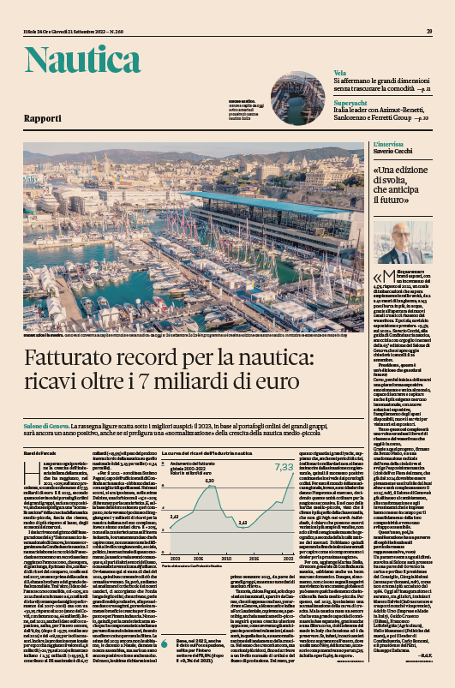
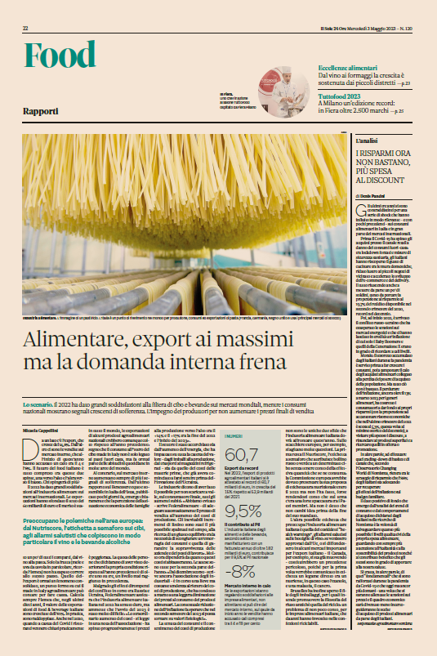
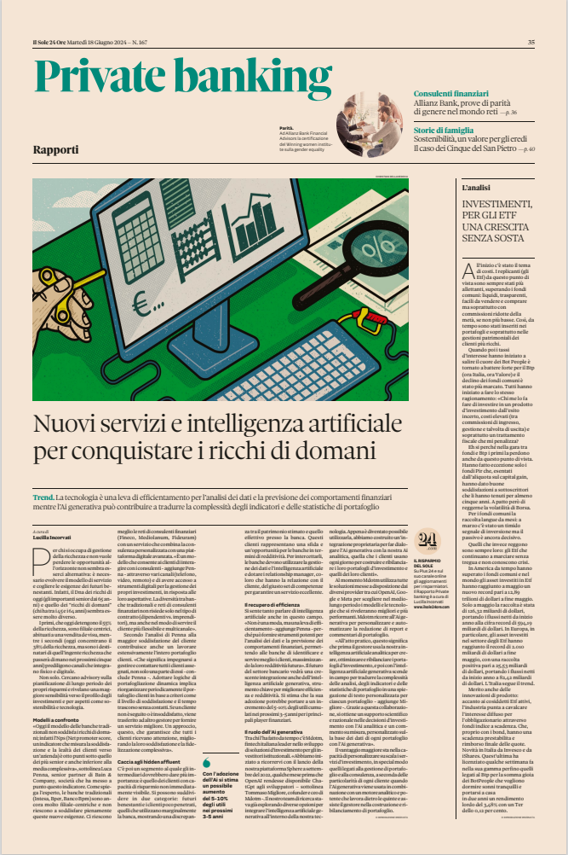
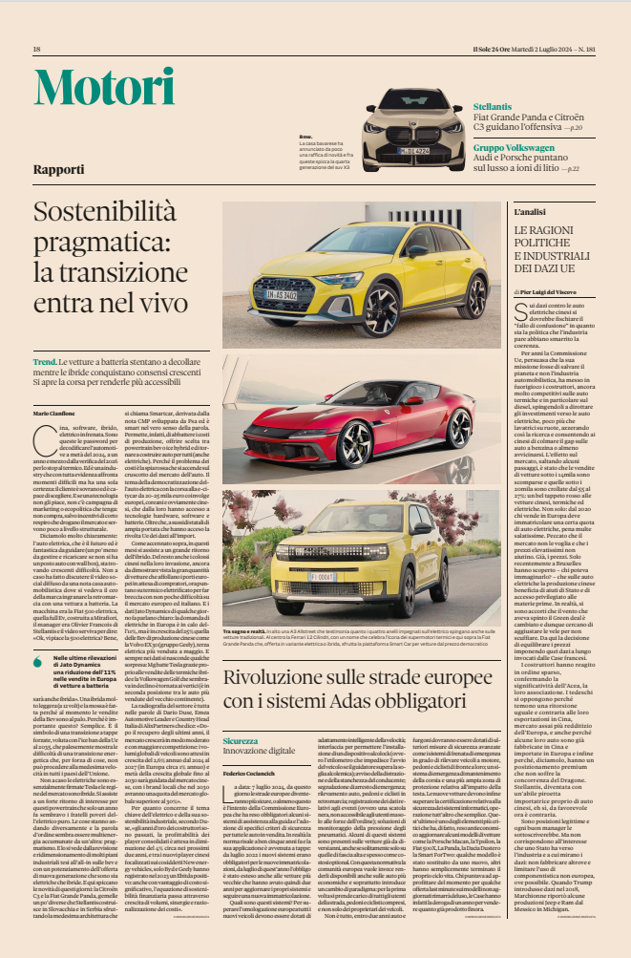
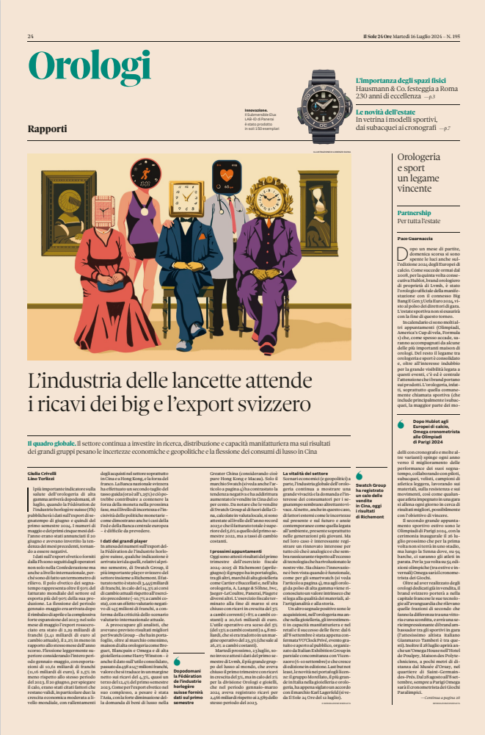

Case history
Some Reports issues scheduled
Reports can be:
-Inside Il Sole 24 Ore
(for example. Industria nautica, Wine, Private banking)
-Ouside Il Sole 24 Ore (second section of the Newspaper)
(for example. Motori, Orologi, Gioielli)
»

Slide 7
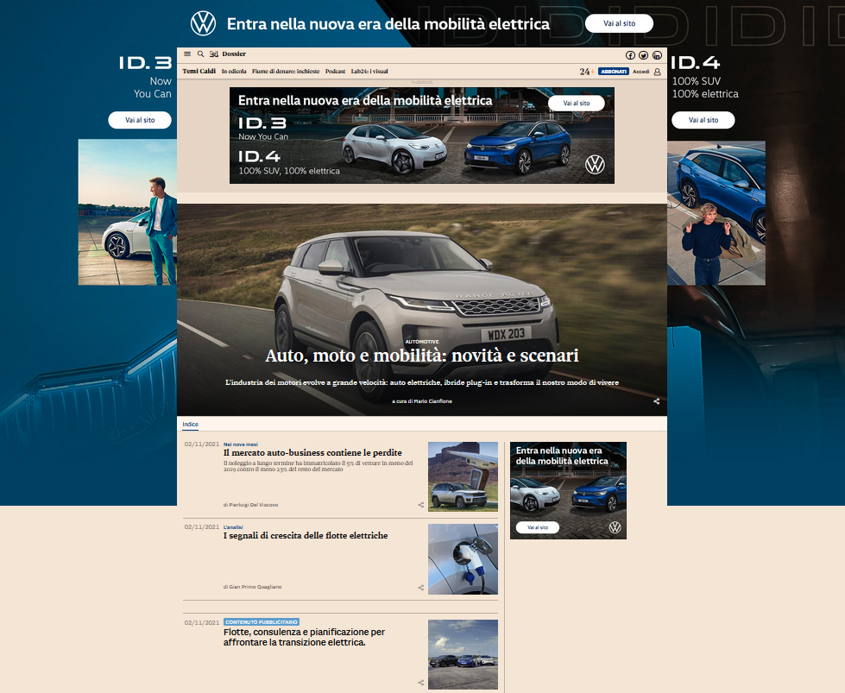
Reports
Digital
The Reports are also available online on the Sole24ore.com website within the relevant editorial section.
Sponsorship can take place in different ways:
- PACKAGE 1 - 6K
- PACKAGE 2 - 8K
- PACKAGE GOLD 20K (with advertising content)
- PACKAGE PLATINUM 25K (with «created for» content)
Monographic Display in page (100% Sov) Skin, Masthead, Mpu Top
Display planning with monographic in reference section (180,000 Imps)
Monographic Display in page (100% Sov) Skin, Masthead, Mpu Top
Push support planning in Brand Connect band position (3,5 MIO Imps)
Gold and Platinum offers include :
Display monographic in page (100% Sov) Skin, Masthead, Mpu Top
Push support planning in Brand Connect band position (2 MIO. Imps)
FB and LinkedIn post and Dossier launch
Sponsored FB and LinekdIn post («Advertising content» or «Created for»)
Amplify campaign Facebook
For the gold and platinum packages, the branded content is contextualized in the dossier and relaunched by the hp of the dossier.
Amplify activities are available asking directly to the Brand Connect account
A COBRAND PROMOTION PLAN IS PROVIDED FOR ALL PACKAGES ON: SITE (BANNER) SOCIAL (LAUNCH POST) EMAIL MARKETING (DEM)
* All editions of the individual thematic reports will be placed into the same digital dossier.

